Slide 1
Angular Components In Web Development
BY:
M.GOPIKA VAISHNAVI
22H51A0538
CSE-D

Slide 2
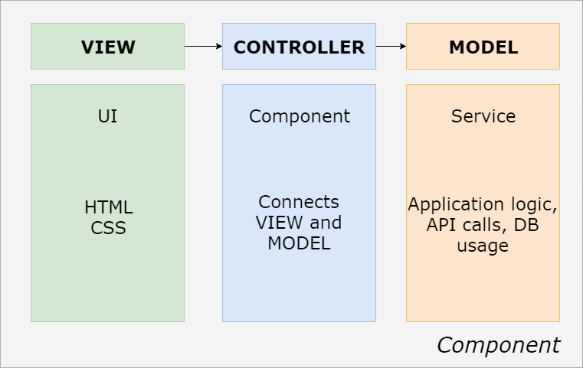
Introduction to Angular Components
Angular is a platform for building web applications using TypeScript.
Components are the building blocks of Angular applications, encapsulating the UI and behavior.
They promote reusability and modularity, making it easier to manage complex apps.
Notes:
Image source: https://www.codestack.net/angular/

Slide 3
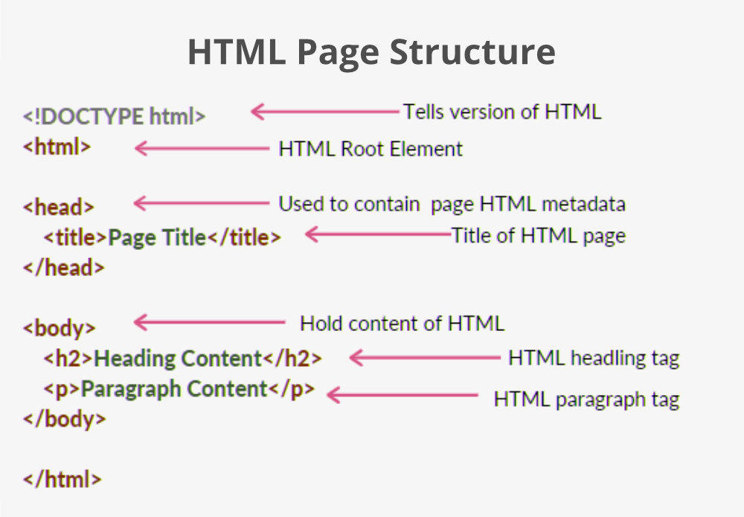
What is a Component?
A component consists of an HTML template,a TypeScript class, and associated styles.
The template defines the view, while the class contains the logic for the view.
Styles can be scoped to the component, allowing for encapsulated styling.
Notes:
Image source: https://www.geeksforgeeks.org/html/

Slide 4
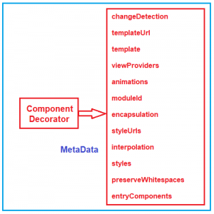
Anatomy of an Angular Component
The component decorator defines metadata such as selector, template URL, and styles.
The class defines properties and methods that dictate the component's behavior.
An example component might look like a simple TypeScript class decorated with `@Component()`.
Notes:
Image source: https://dotnettutorials.net/lesson/angular-component-decorator/

Slide 5
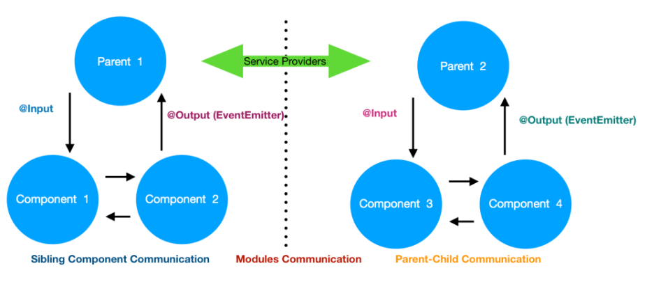
Component Communication
Components can communicate with each other using Input and Output properties.
Input properties allow a parent component to pass data to a child component.
Output properties enable child components to emit events to their parent components.
Notes:
Image source: https://jayanttripathy.com/angular-component-communication/

Slide 6
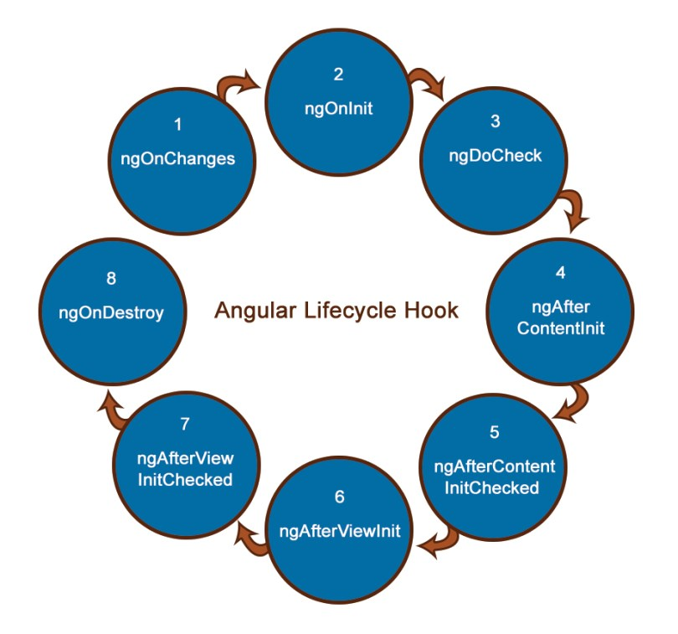
Lifecycle Hooks
Angular components have a lifecycle managed by Angular itself.
Lifecycle hooks allow developers to tap into key events in a component’s life, like initialization and destruction.
Common lifecycle hooks include `ngOnInit()`, `ngOnChanges()`, and `ngOnDestroy()`.
Notes:
Image source: https://blog.knoldus.com/angular-lifecycle-hooks/

Slide 7
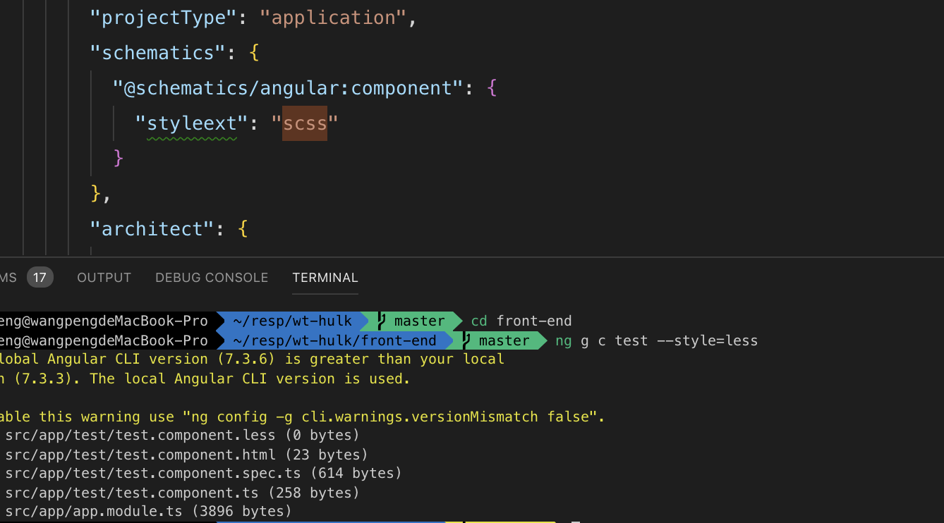
Creating a Component
To create a component, you can use the Angular CLI with the command `ng generate component component-name`.
This command generates the necessary files and updates the module accordingly.
The newly created component can then be used in templates and other components.
Notes:
Image source: https://campolden.org/post/how-to-create-angular-component-in-visual-studio-code.html?save=1

Slide 8
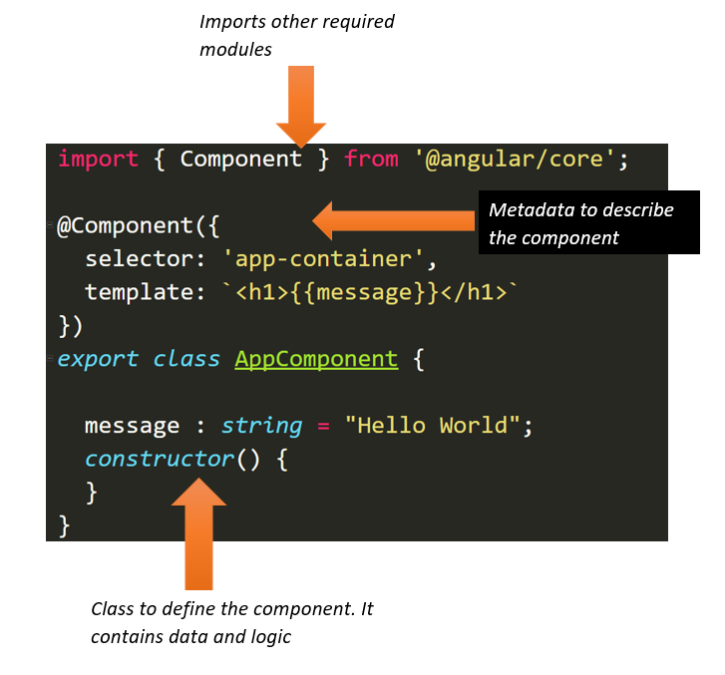
Component Styles
Angular allows you to apply styles directly to components to avoid style conflicts.
Styles can be defined in the component's metadata using the `styles` or `styleUrls` properties.
Angular also supports encapsulation strategies such as Emulated, Native, and None.
Notes:
Image source: https://www.infragistics.com/community/blogs/b/dhananjay_kumar/posts/introduction-to-angular-2-components

Slide 9
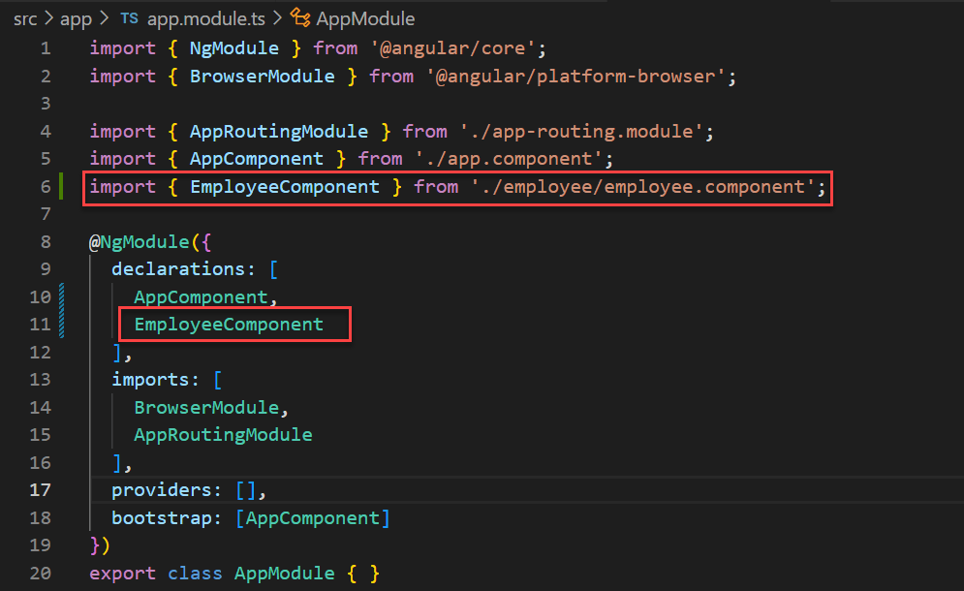
Nested Components
Angular allows the creation of nested components, enabling a hierarchical structure.
Parent components can manage the state and behavior of child components effectively.
This structure promotes a clear separation of concerns and better organization of code.
Notes:
Image source: https://jayanttripathy.com/angular-nested-components/

Slide 10
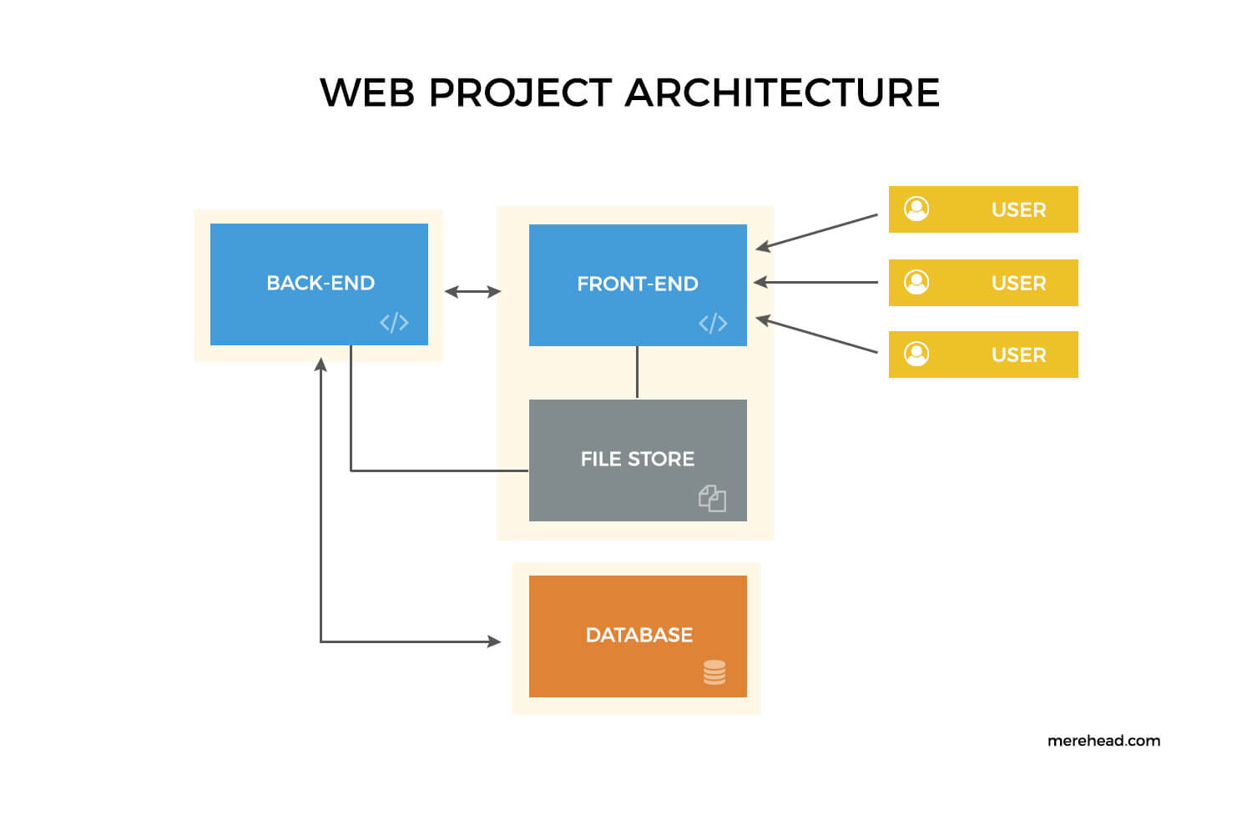
Conclusion
Angular components are essential for building scalable and maintainable web applications.
Understanding components and their lifecycle is crucial for effective Angular development.
By following best practices, developers can create robust applications that leverage Angular's capabilities.
Notes:
Image source: https://merehead.com/blog/how-build-scalable-web-applications/

Slide 11
THANKYOU….

